Slide 1

School of Computing Science and Engineering
Program: B.Tech
Course Code: BCSE3069
Course Name: Computer Graphics
Teacher : M.Arvindhan

Slide 2
School of Computing Science and Engineering Course Code : BTCS2401 Course Name: Computer Graphics
Unit-2: Transformations
Basic transformation, Matrix representations and homogenous coordinates, Composite transformations, Reflections and shearing. Windowing and Clipping: Viewing pipeline, Viewing transformations, 2-D Clipping algorithms-Line clipping algorithms such as Cohen Sutherland line clipping algorithm, Liang Barskyalgorithm, Line clipping against non rectangular clip windows; Polygon clipping – SutherlandHodgeman polygon clipping, Weiler and Atherton polygon clipping, Curve clipping, Text clipping.
Name of the Faculty: Ravi Sharma Program:B.Tech

Slide 3
School of Computing Science and Engineering Course Code : BTCS2401 Course Name: Computer Graphics
Transformation
The term Transformation is generally referred to as converting a graphic into another graphic by applying some rules or algorithms. Sometimes an image or picture can be a combination of lines, rectangle, circle, and triangle. If we draw the basic and combination of pictures, then there should be a need to transform these images.
Now we can perform the following actions to transform the images-
We can change the position of an image.
We can increase or decrease the size of an image.
We can change the angle of the image.
The object transformation includes two important points-
Geometric Transformation: When we are moving the picture, and the background is fixed, then it is a Geometric Transformation.
Coordinate Transformation: When we are moving the background, and the picture is fixed, then it is Coordinate Transformation.
Name of the Faculty: Ravi Sharma Program:B.Tech

Slide 4
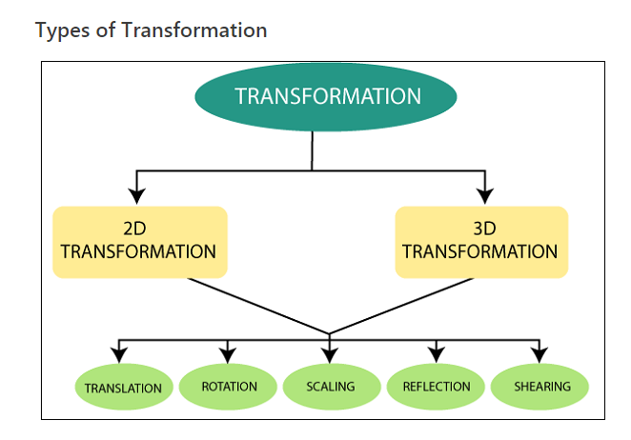
School of Computing Science and Engineering Course Code : BTCS2401 Course Name: Computer Graphics
Name of the Faculty: Ravi Sharma Program:B.Tech

Slide 5
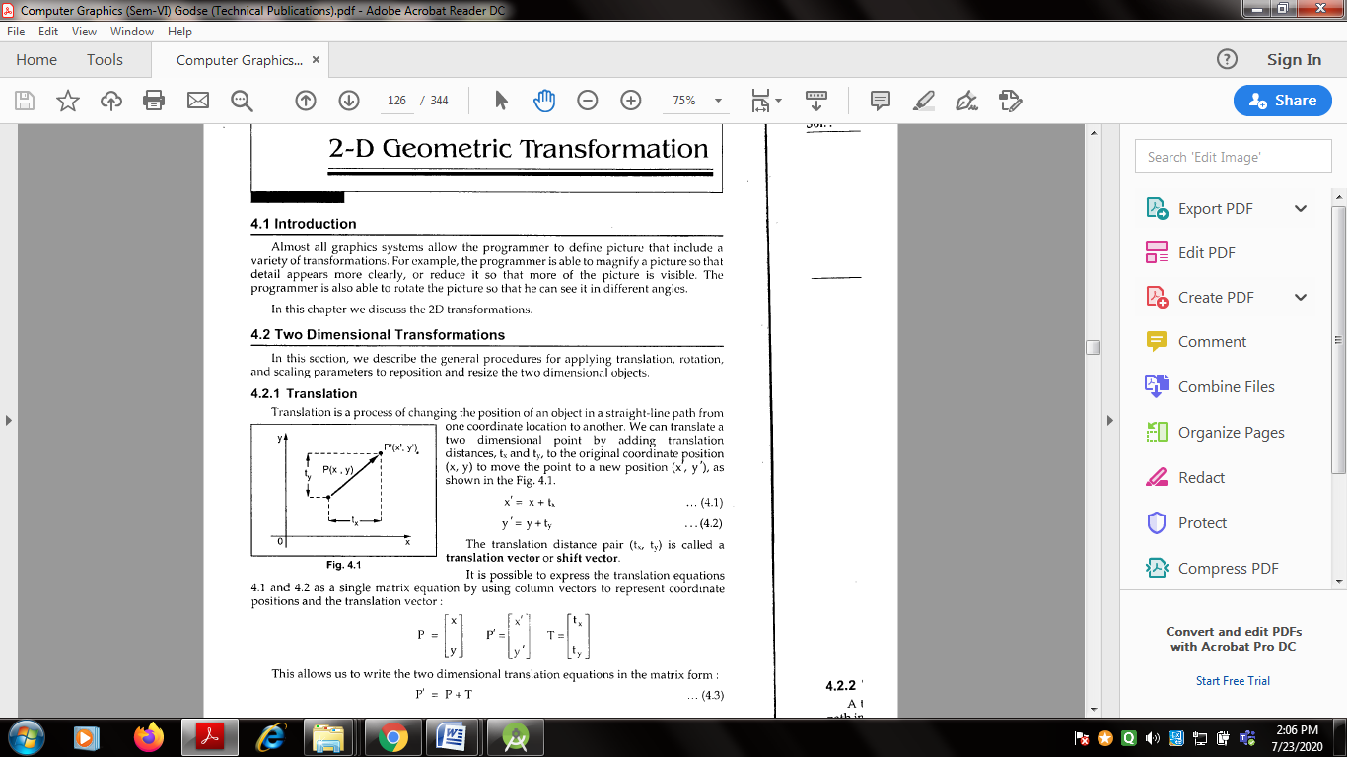
School of Computing Science and Engineering Course Code : BTCS2401 Course Name: Computer Graphics
Name of the Faculty: Ravi Sharma Program:B.Tech

Slide 6
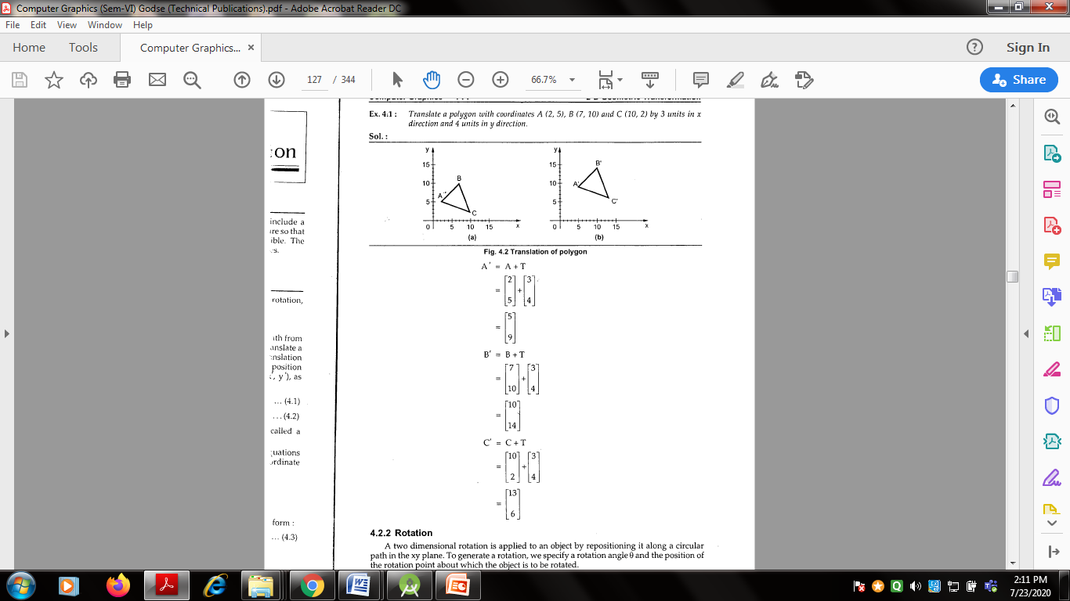
School of Computing Science and Engineering Course Code : BTCS2401 Course Name: Computer Graphics
Name of the Faculty: Ravi Sharma Program:B.Tech

Slide 7
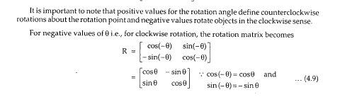
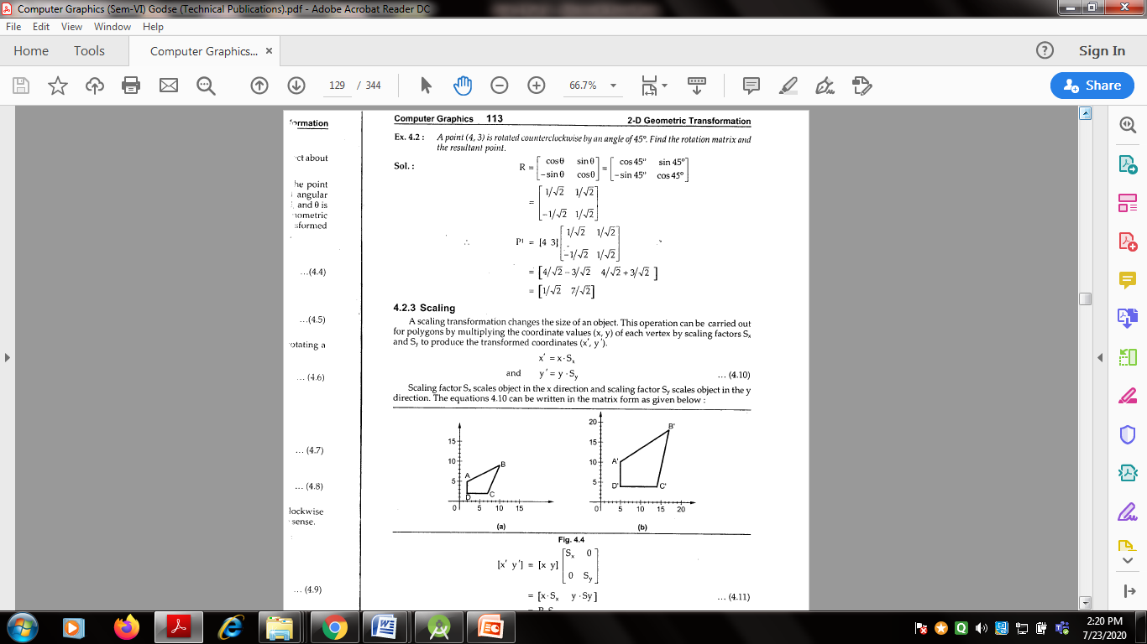
School of Computing Science and Engineering Course Code : BTCS2401 Course Name: Computer Graphics
Name of the Faculty: Ravi Sharma Program:B.Tech

Slide 8
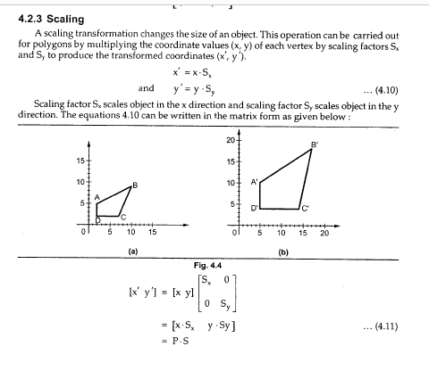
School of Computing Science and Engineering Course Code : BTCS2401 Course Name: Computer Graphics
Name of the Faculty: Ravi Sharma Program:B.Tech

Slide 9
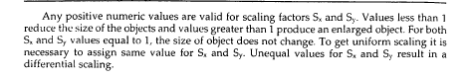
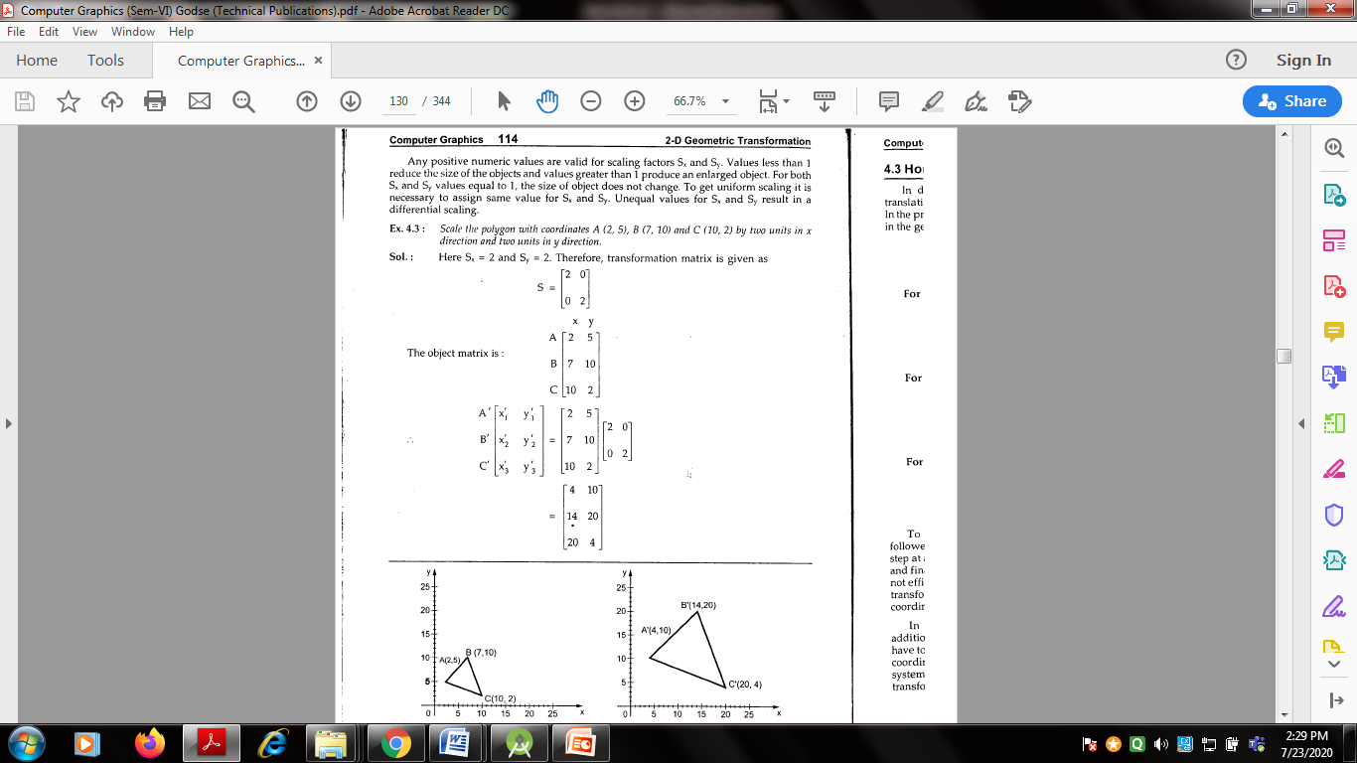
School of Computing Science and Engineering Course Code : BTCS2401 Course Name: Computer Graphics
Name of the Faculty: Ravi Sharma Program:B.Tech

Slide 10
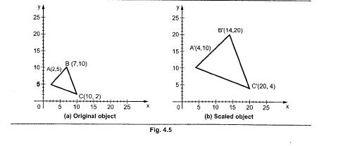
School of Computing Science and Engineering Course Code : BTCS2401 Course Name: Computer Graphics
Name of the Faculty: Ravi Sharma Program:B.Tech

Slide 11


